Slide 1
Household Income Inequality by Race in the United States
Project II
DSC 680
Alberto Luma

Slide 2
Table of Contents
Introduction
Research Questions
Dataset Summary
Graphs and Table
Models Selection and Performance
Conclusion

Slide 3
Introduction
Ethnically speaking, Blacks and Hispanics have faced economic inequality for generations, and the recent wave of Black Lives Matter protests has renewed discussions on these disparities. Compared to White families, other races have lower levels of income and net worth.
They are also less likely to hold assets of any type. In fact, 19% of Black families have zero or negative net worth, while only 9% of White households have no wealth
Income inequality is defined as the extent to which income is distributed unevenly in a group of people. In mostly every culture, most people’s economic positions are also related to other characteristics, such as whether or not they have a disability, their ethnic background, or whether they are a man or a woman

Slide 4
Research Questions
Does wealth inequality exist in the United States?
wage may be the key determinant of income inequality. Since the 1980s, slower economic growth, higher unemployment and reduced wage shares have been observed in the U.S
Does racial diversity play a role in the income and wealth inequality in the United
States?
we know that education has played a big role in income and wealth inequality in America. One general analysis of the educational importance in wealth is the fact that we can clearly see the difference of educated Blacks and Hispanic and the uneducated ones when it comes to quality of life.
Which states that have the highest minority income?
We know that whites and Asians fare much better than Hispanics and blacks. The gap is even wider when restricting the comparison to just middle-aged, well-educated families in each of the four groups.

Slide 5
Data Summary
The first data is called “Average Income by State by Race”. We know that education
plays a big role in income. This dataset does not reflect any educational background.
This dataset will be analyzed to determine the average income of each race in each state
in the United States. It will also help us understand the gap between white Americans,
African-Americans, Hispanic, Asians, and Native American is particularly conspicuous,
not only because these are the five largest racial groups in the U.S., but also because
they are the five groups that hold the most wealth per capita and the least wealth per
capita.
Data source: https://www.census.gov/search
results.html?q=income+by+race+in++florida&page=1&stateGeo=none&searchtype=web
&cssp=SERP&_charset_=UTF-8
The second data is called “State Population by Race”. This dataset will be used almost the same way as Average income by state by race. The goal of this dataset is to use it to prove that prove that these five groups are the most populated groups in the United States.

Slide 6
Statistical and Visual Methods
Statistical Methods
Statistical Methods
I will use R and Power BI for this project.
I have decided to examine the association between obesity independent variables and state percentage of poverty prevalence by using ordinary least squares (OLS).
OLS is a variation of linear regression, a statistical method that examines associations between multiple independent variables and a single dependent variable; once the assumptions are satisfied, the regression output indicates the strength of the association between the dependent variable and each of the independent variables.
I am not very comfortable using R, but I am sure that its applications are very well aligned with this type of projects.
I will use ggplot which gives me a coherent way to produce visualizations by expressing relationships between the attributes of data and their graphical representation.
I will use R Markdown to allow me to create documents that serve as a neat record of your analysis. And finally, I may use Dplyr for data manipulation if I need it.

Slide 7
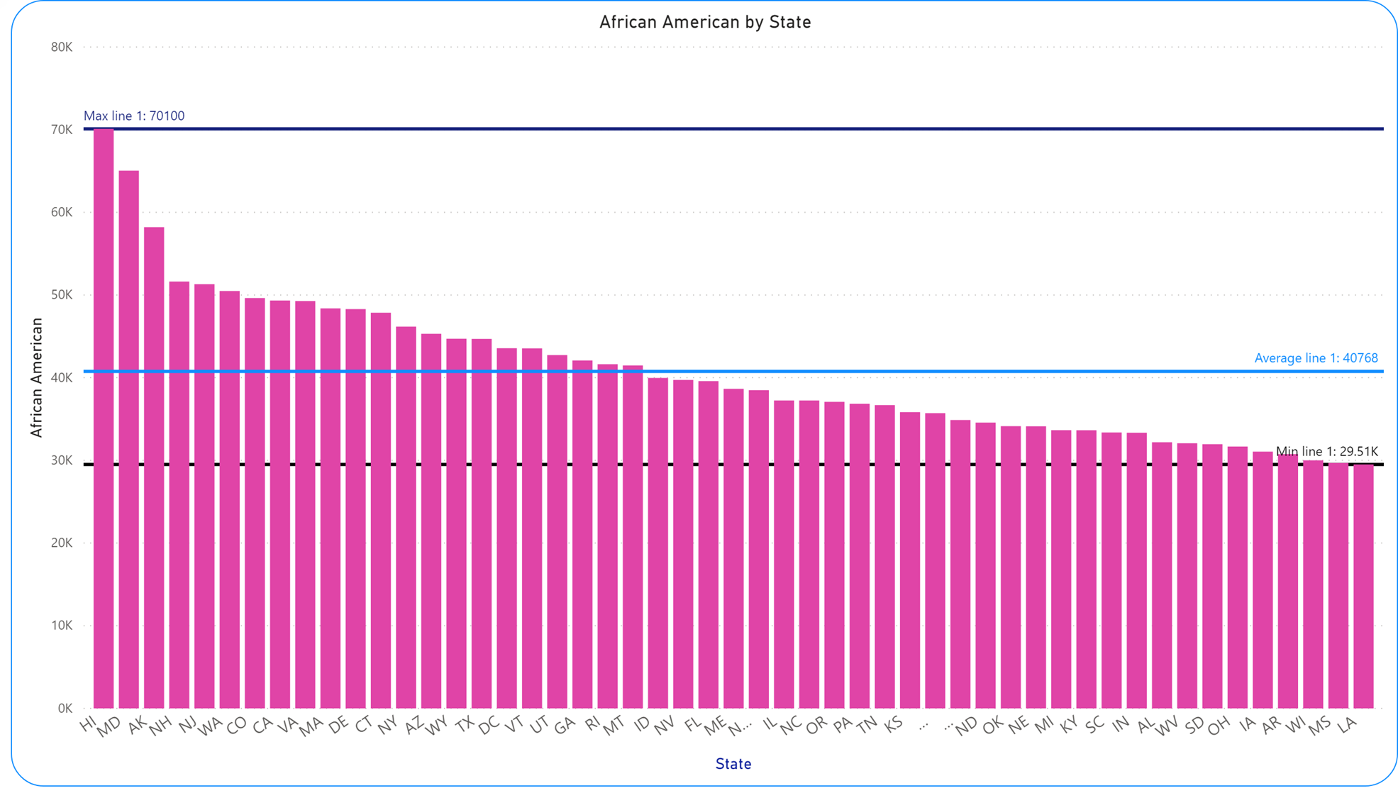
Graphs

Slide 8
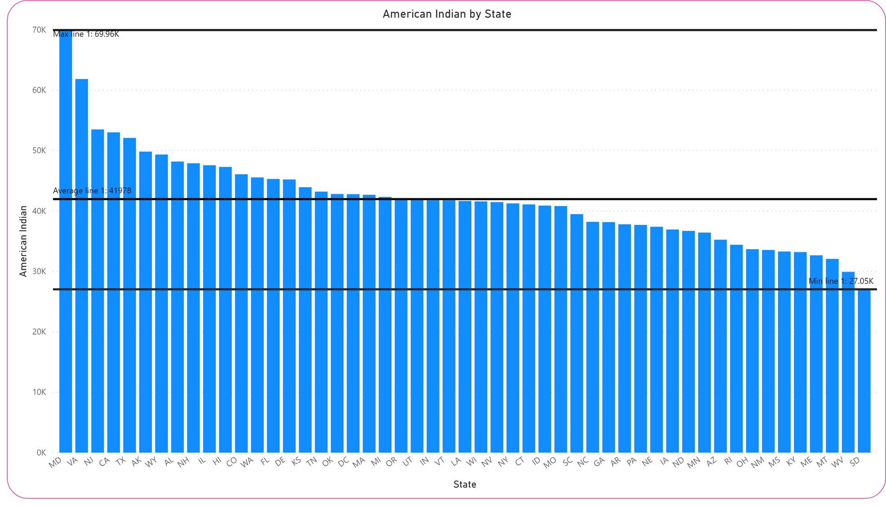
Graphs

Slide 9
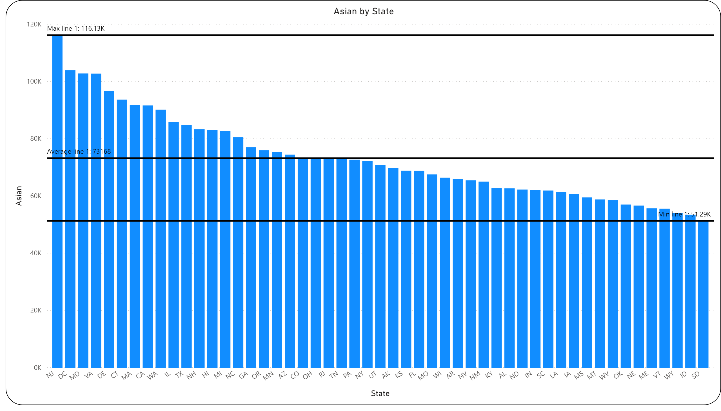
Graphs

Slide 10

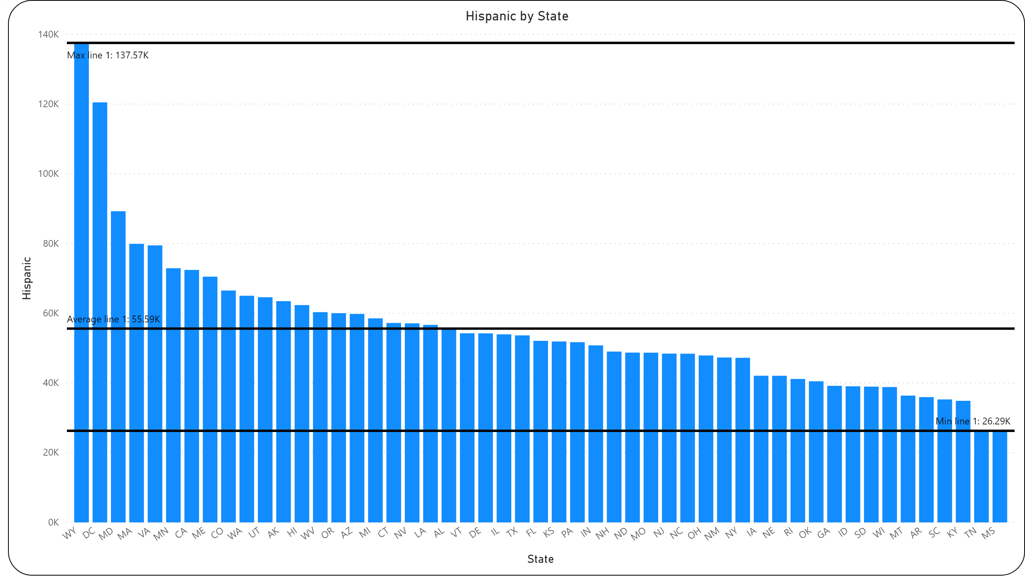

Slide 11
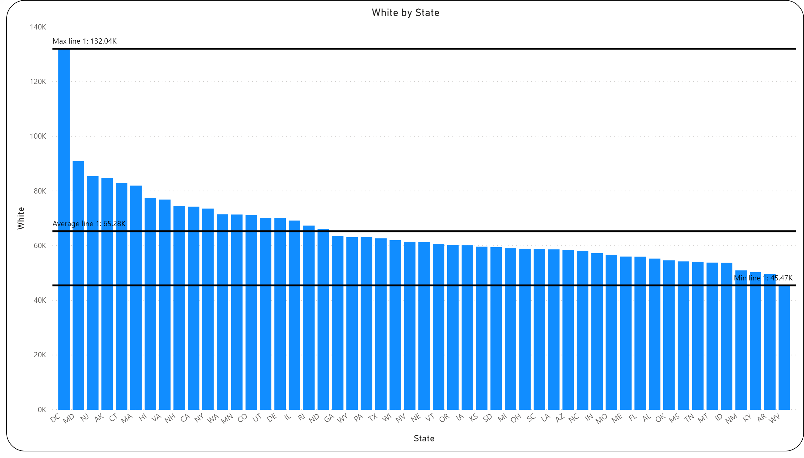

Slide 12
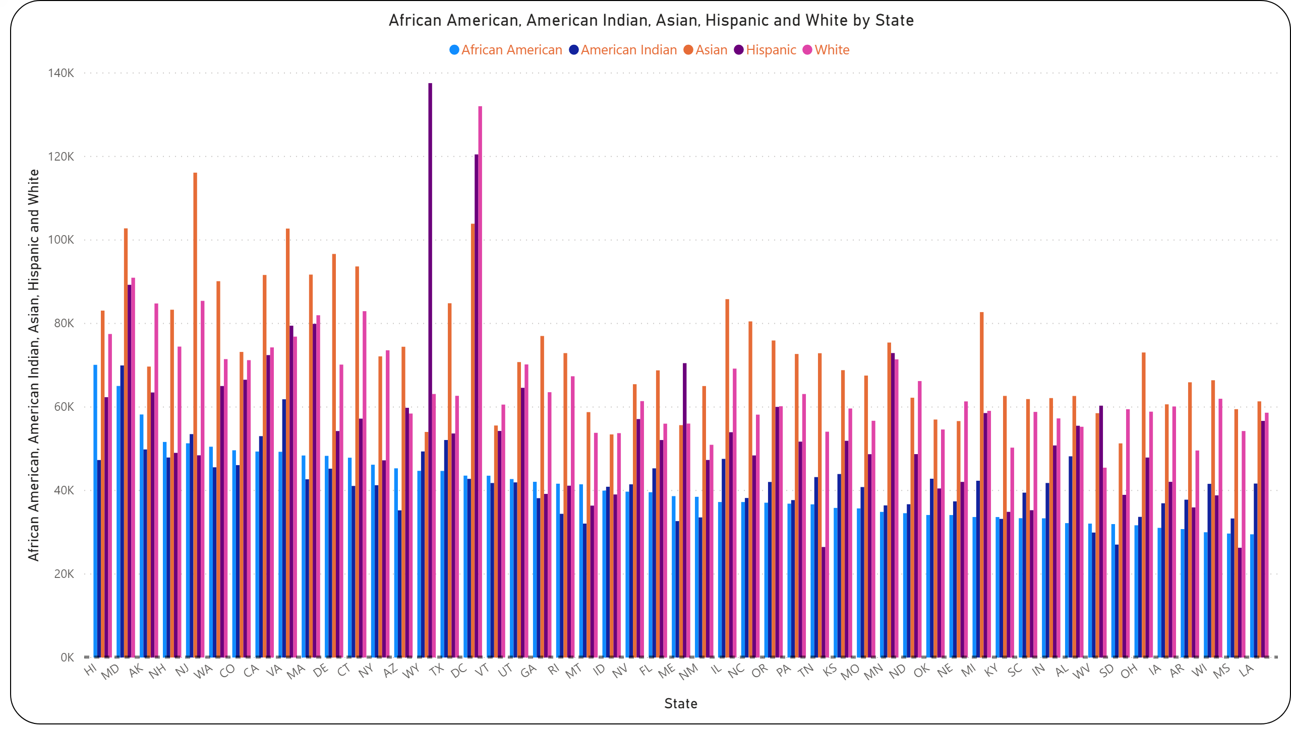

Slide 13

 | White |  | African American |  | American Indian |  | Asian |  | Hispanic
 | State | Amount | State | Amount |  |  | State | Amount | State | Amount
Minimum | West Virginia | $45.47K | Louisiana | $29.51K | South Dakota | $27.05K | South Dakota | $51.29K | Mississippi | $26.29K
Maximum | District of Columbia | $132.04K | Hawaii | $70.1K | Maryland | $69.96K | New Jersey | $116.13K | Wyoming | $120.01K
Average | $65.28K |  | $40.77K |  | $41.98K |  | $73.17K |  | $55.59K

Slide 14
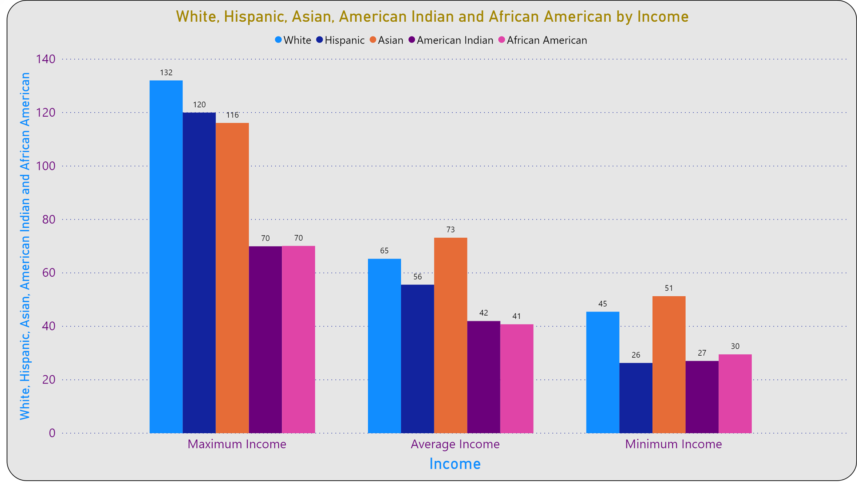
Graph of Table

Slide 15
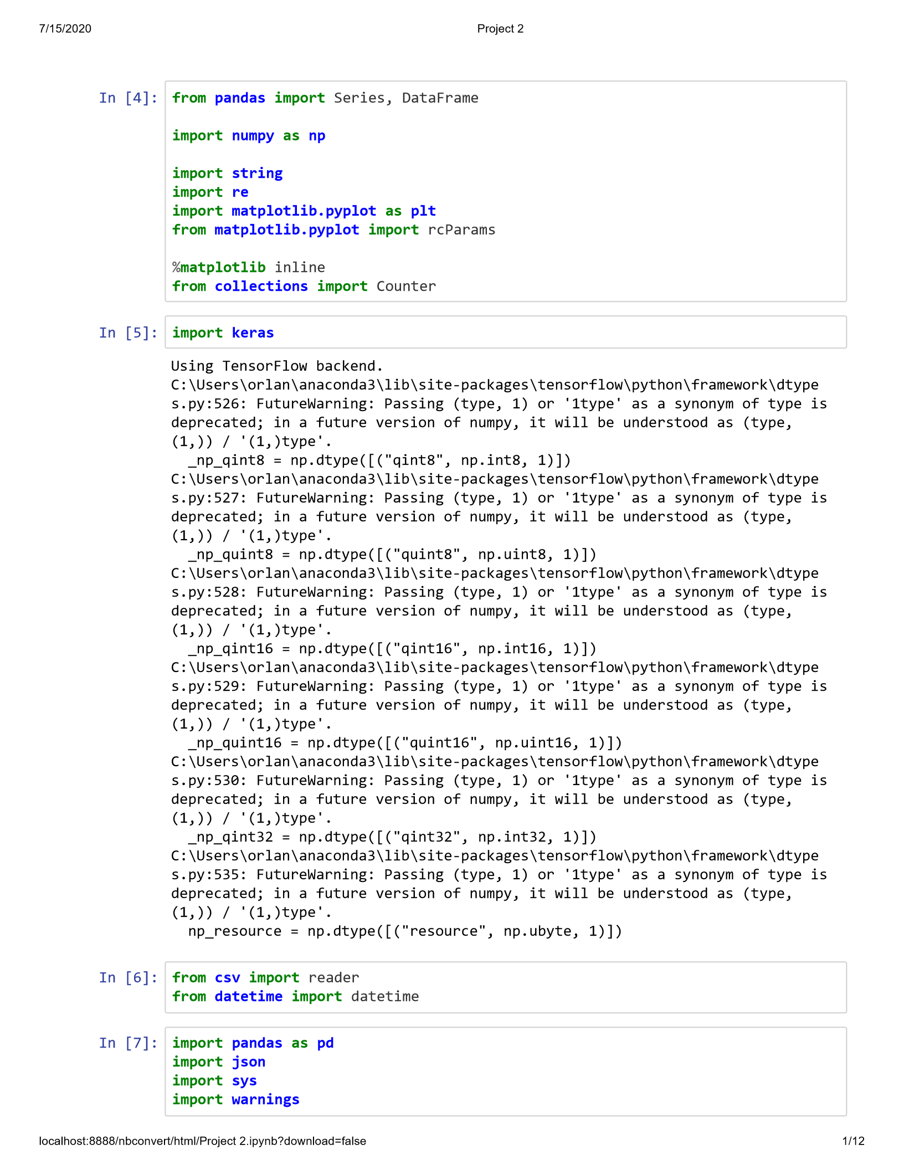
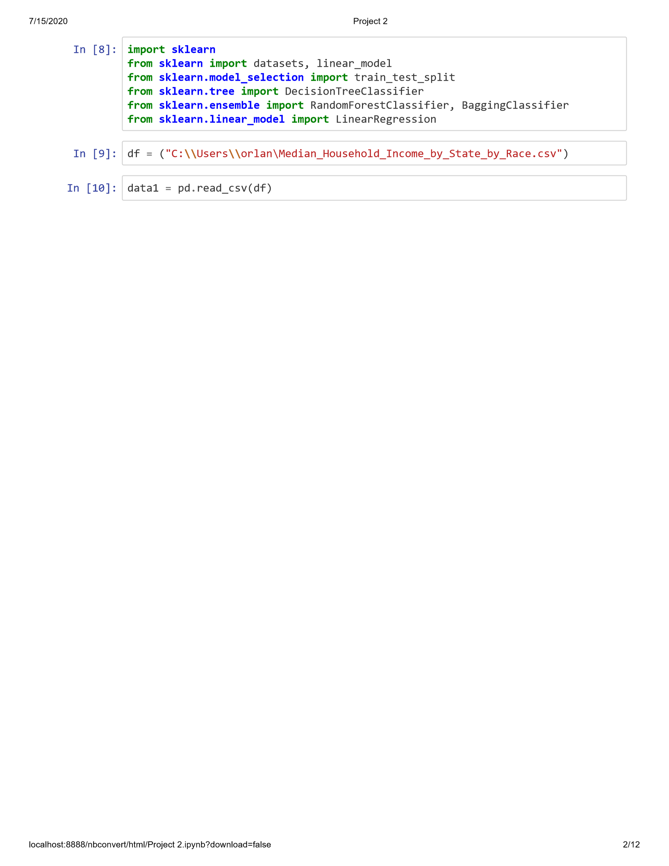

Slide 16
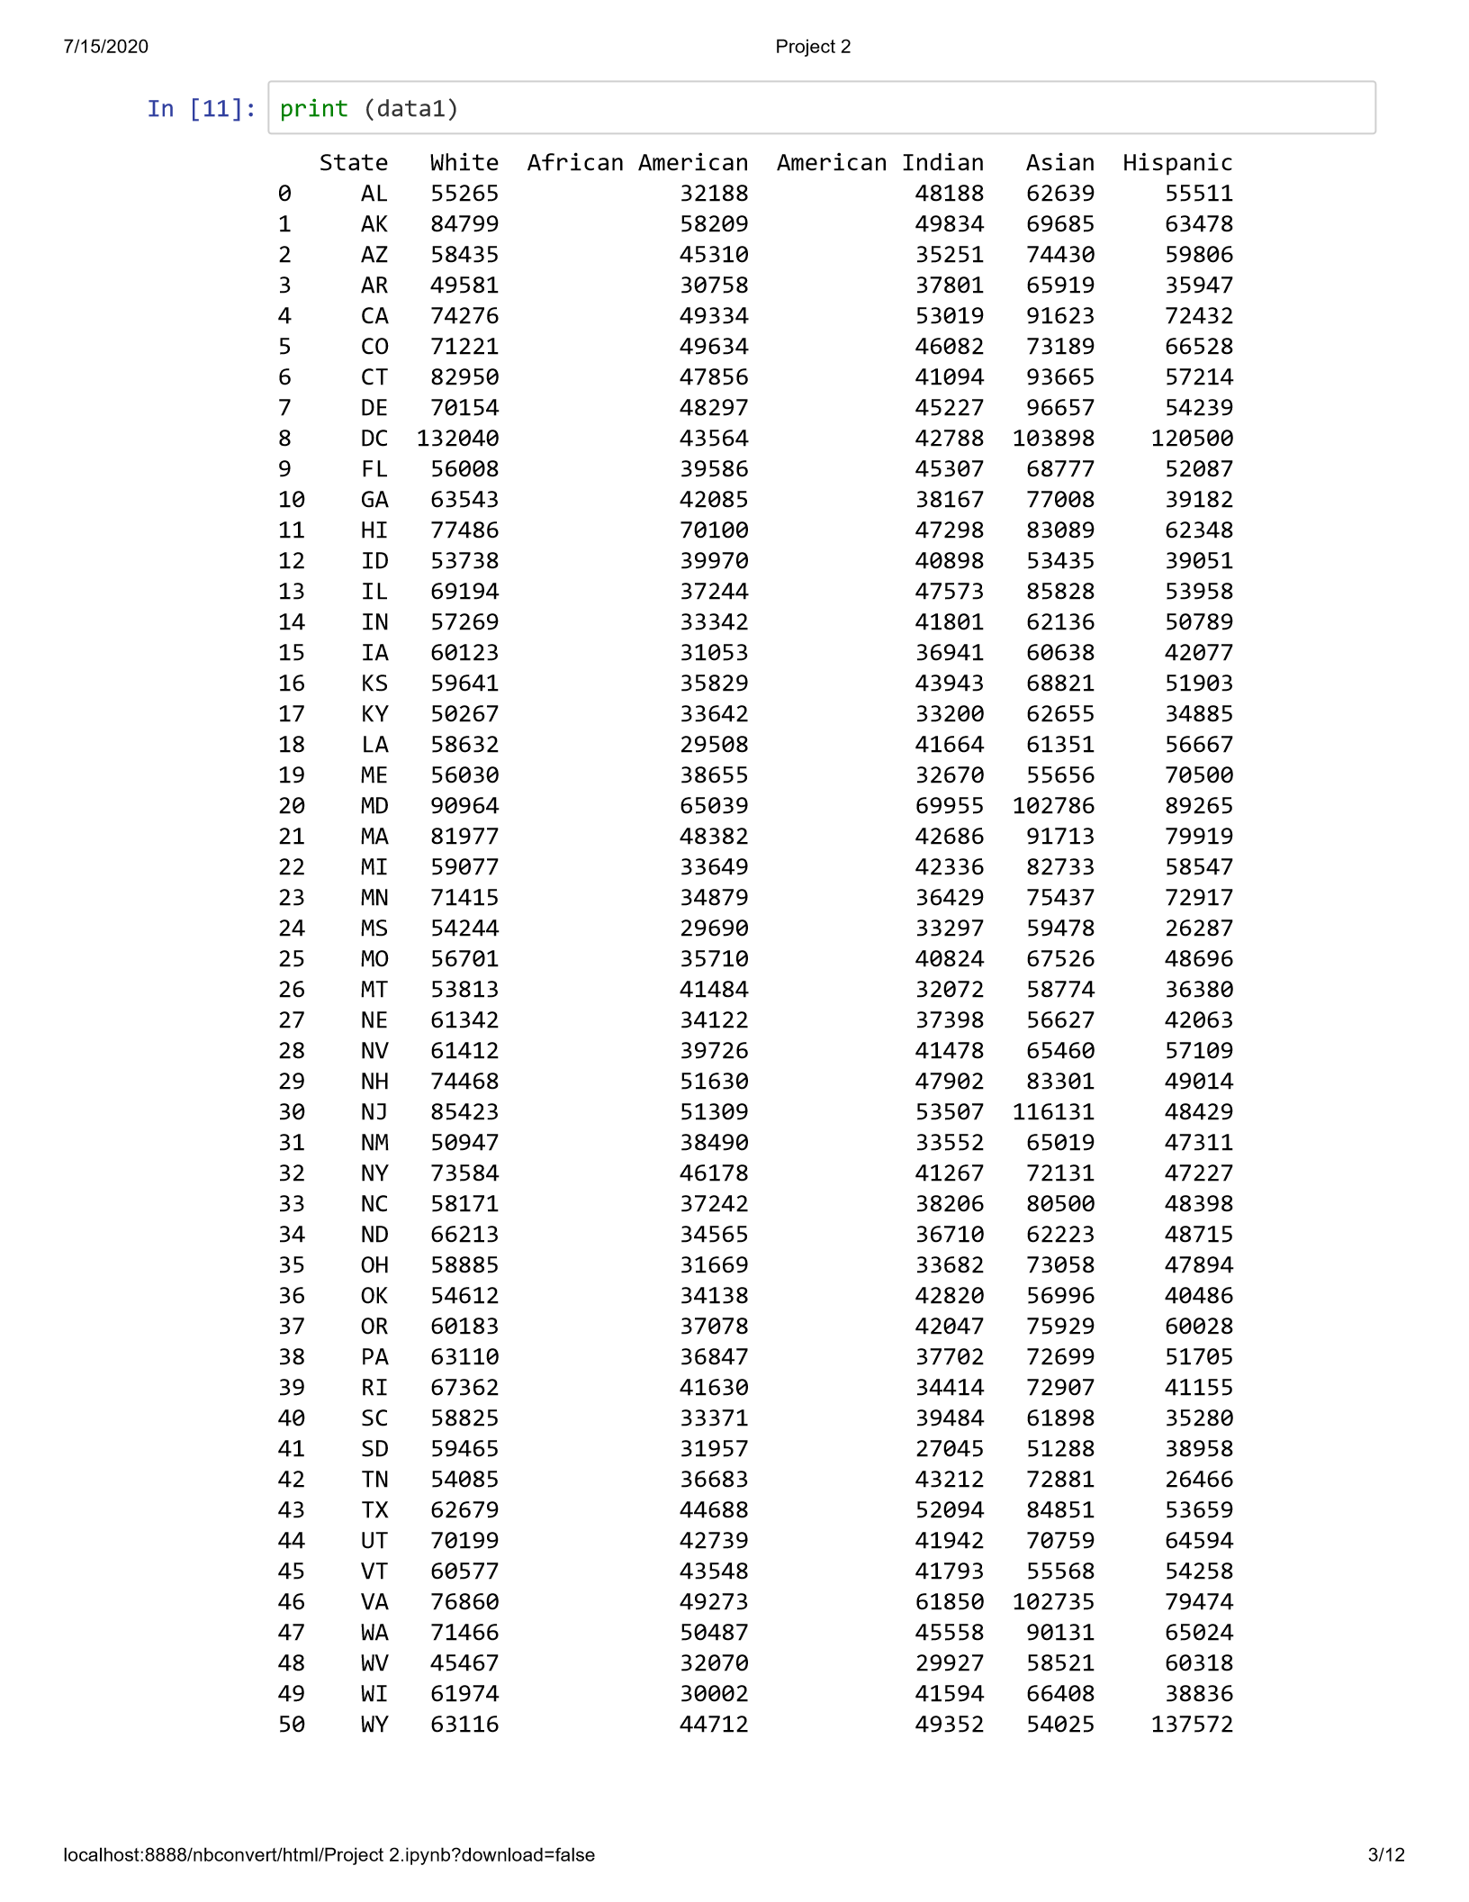
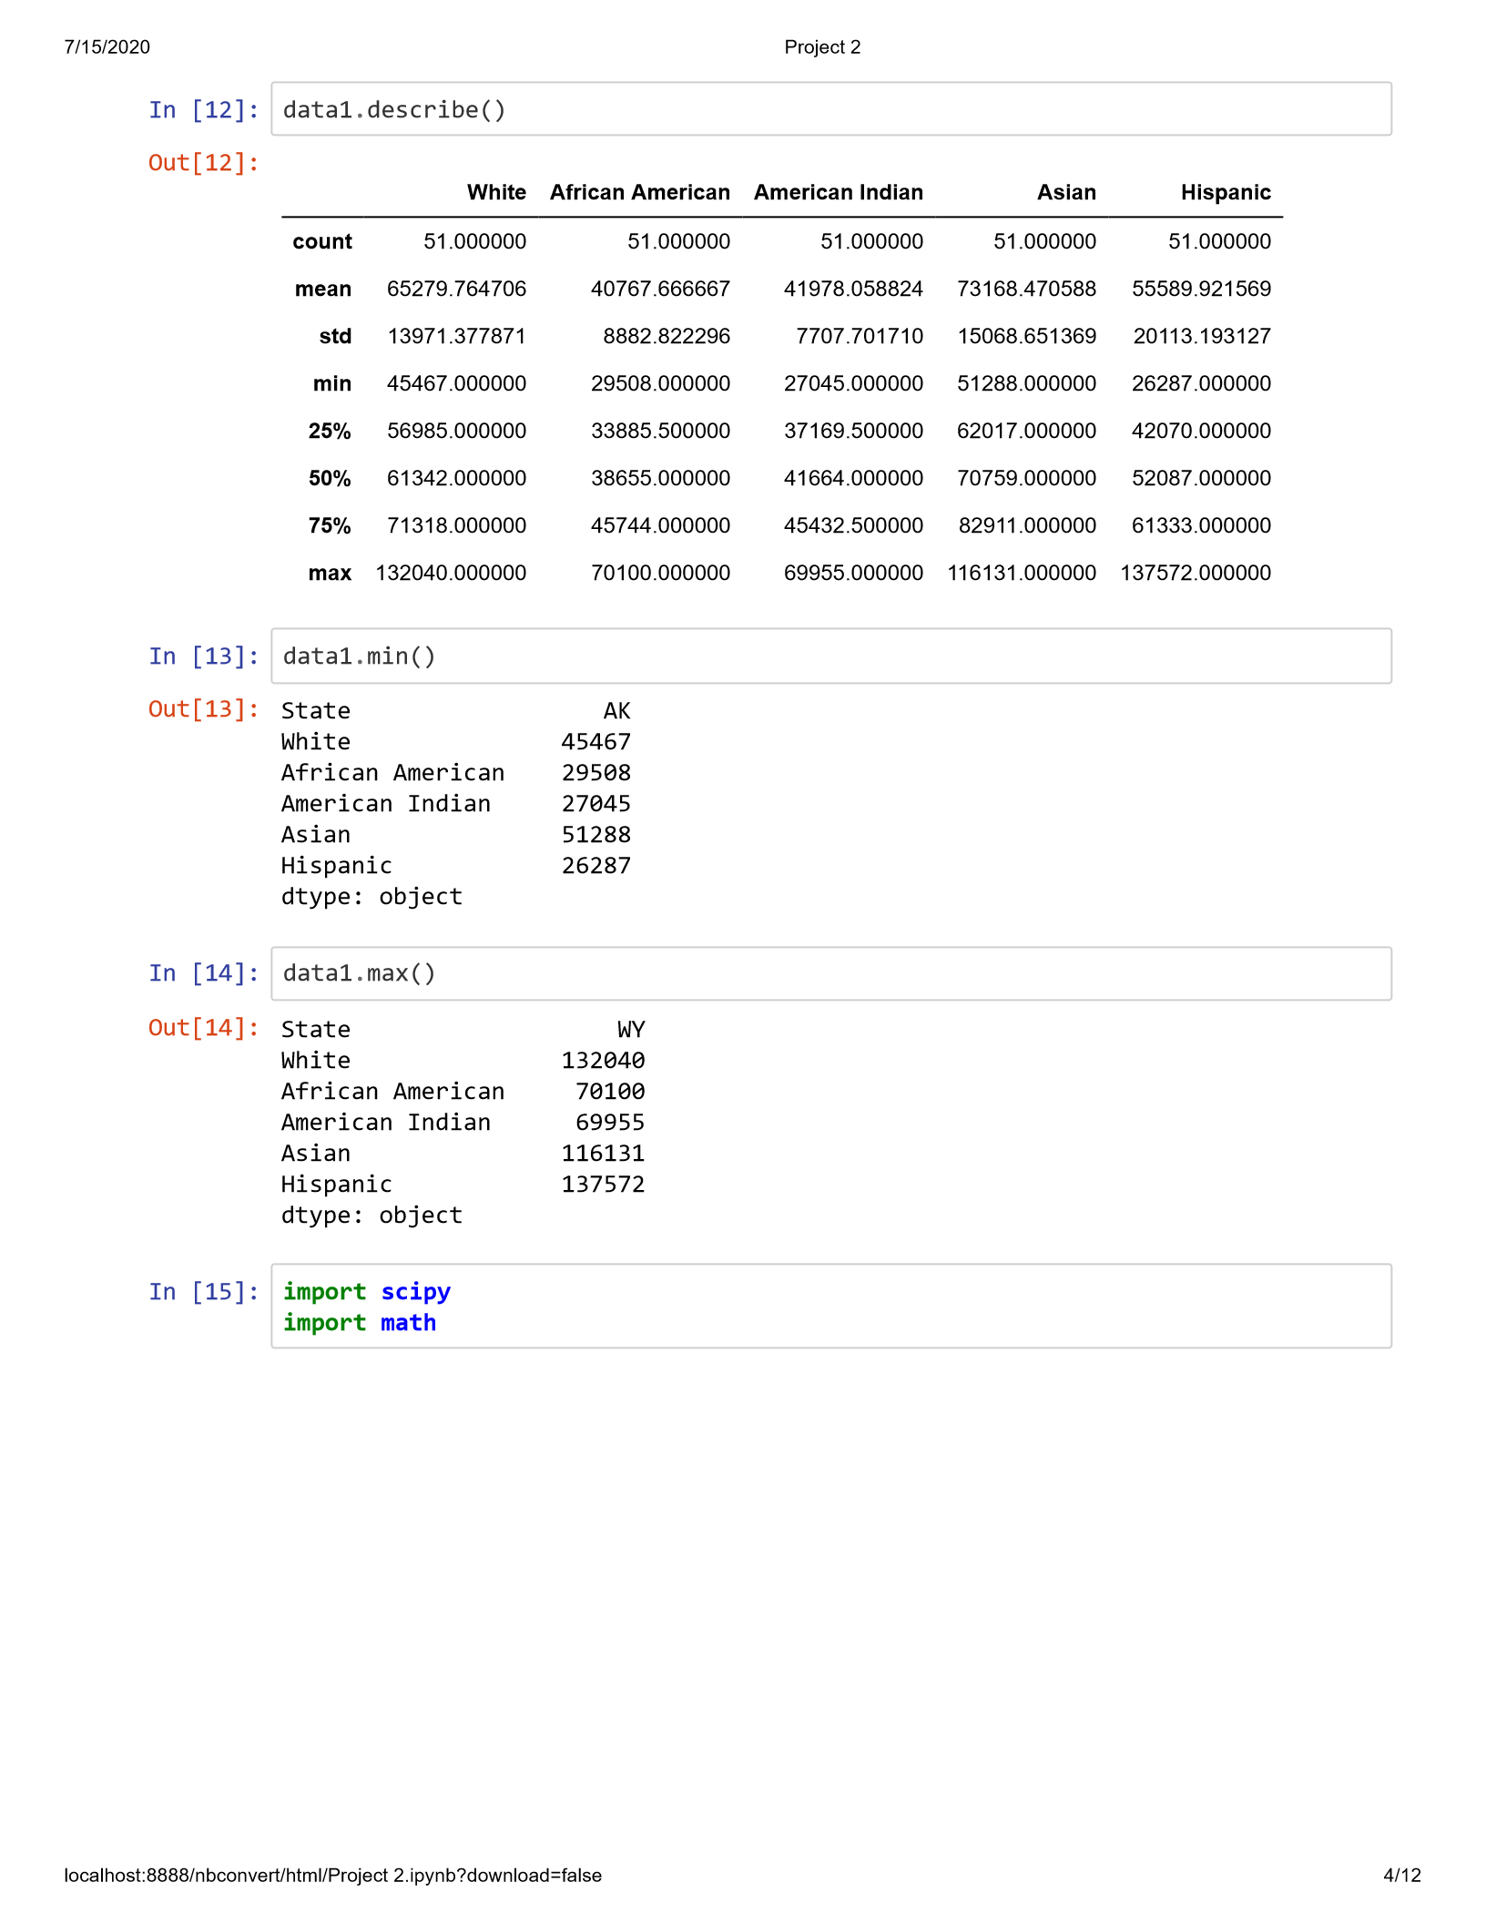

Slide 17
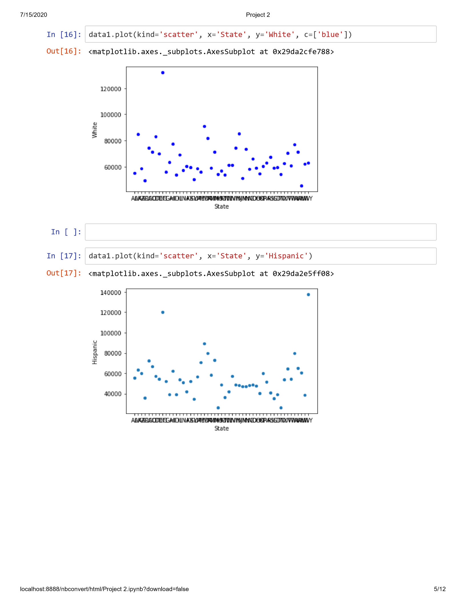
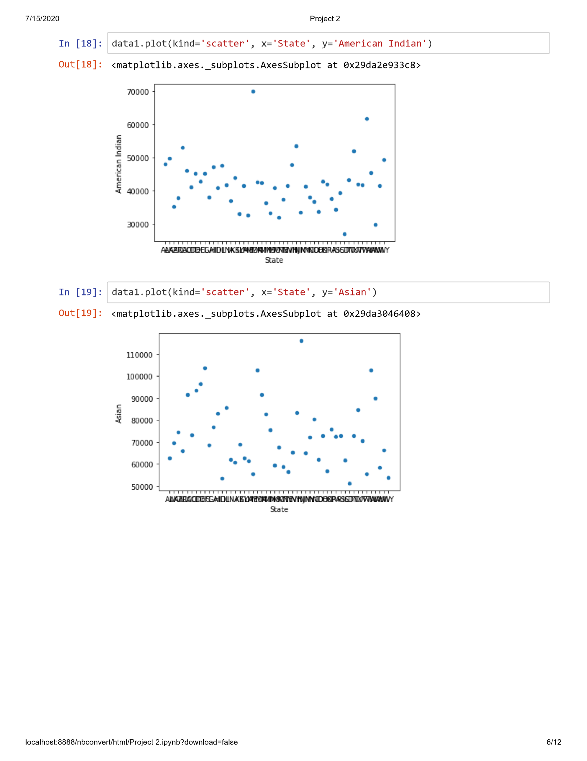

Slide 18
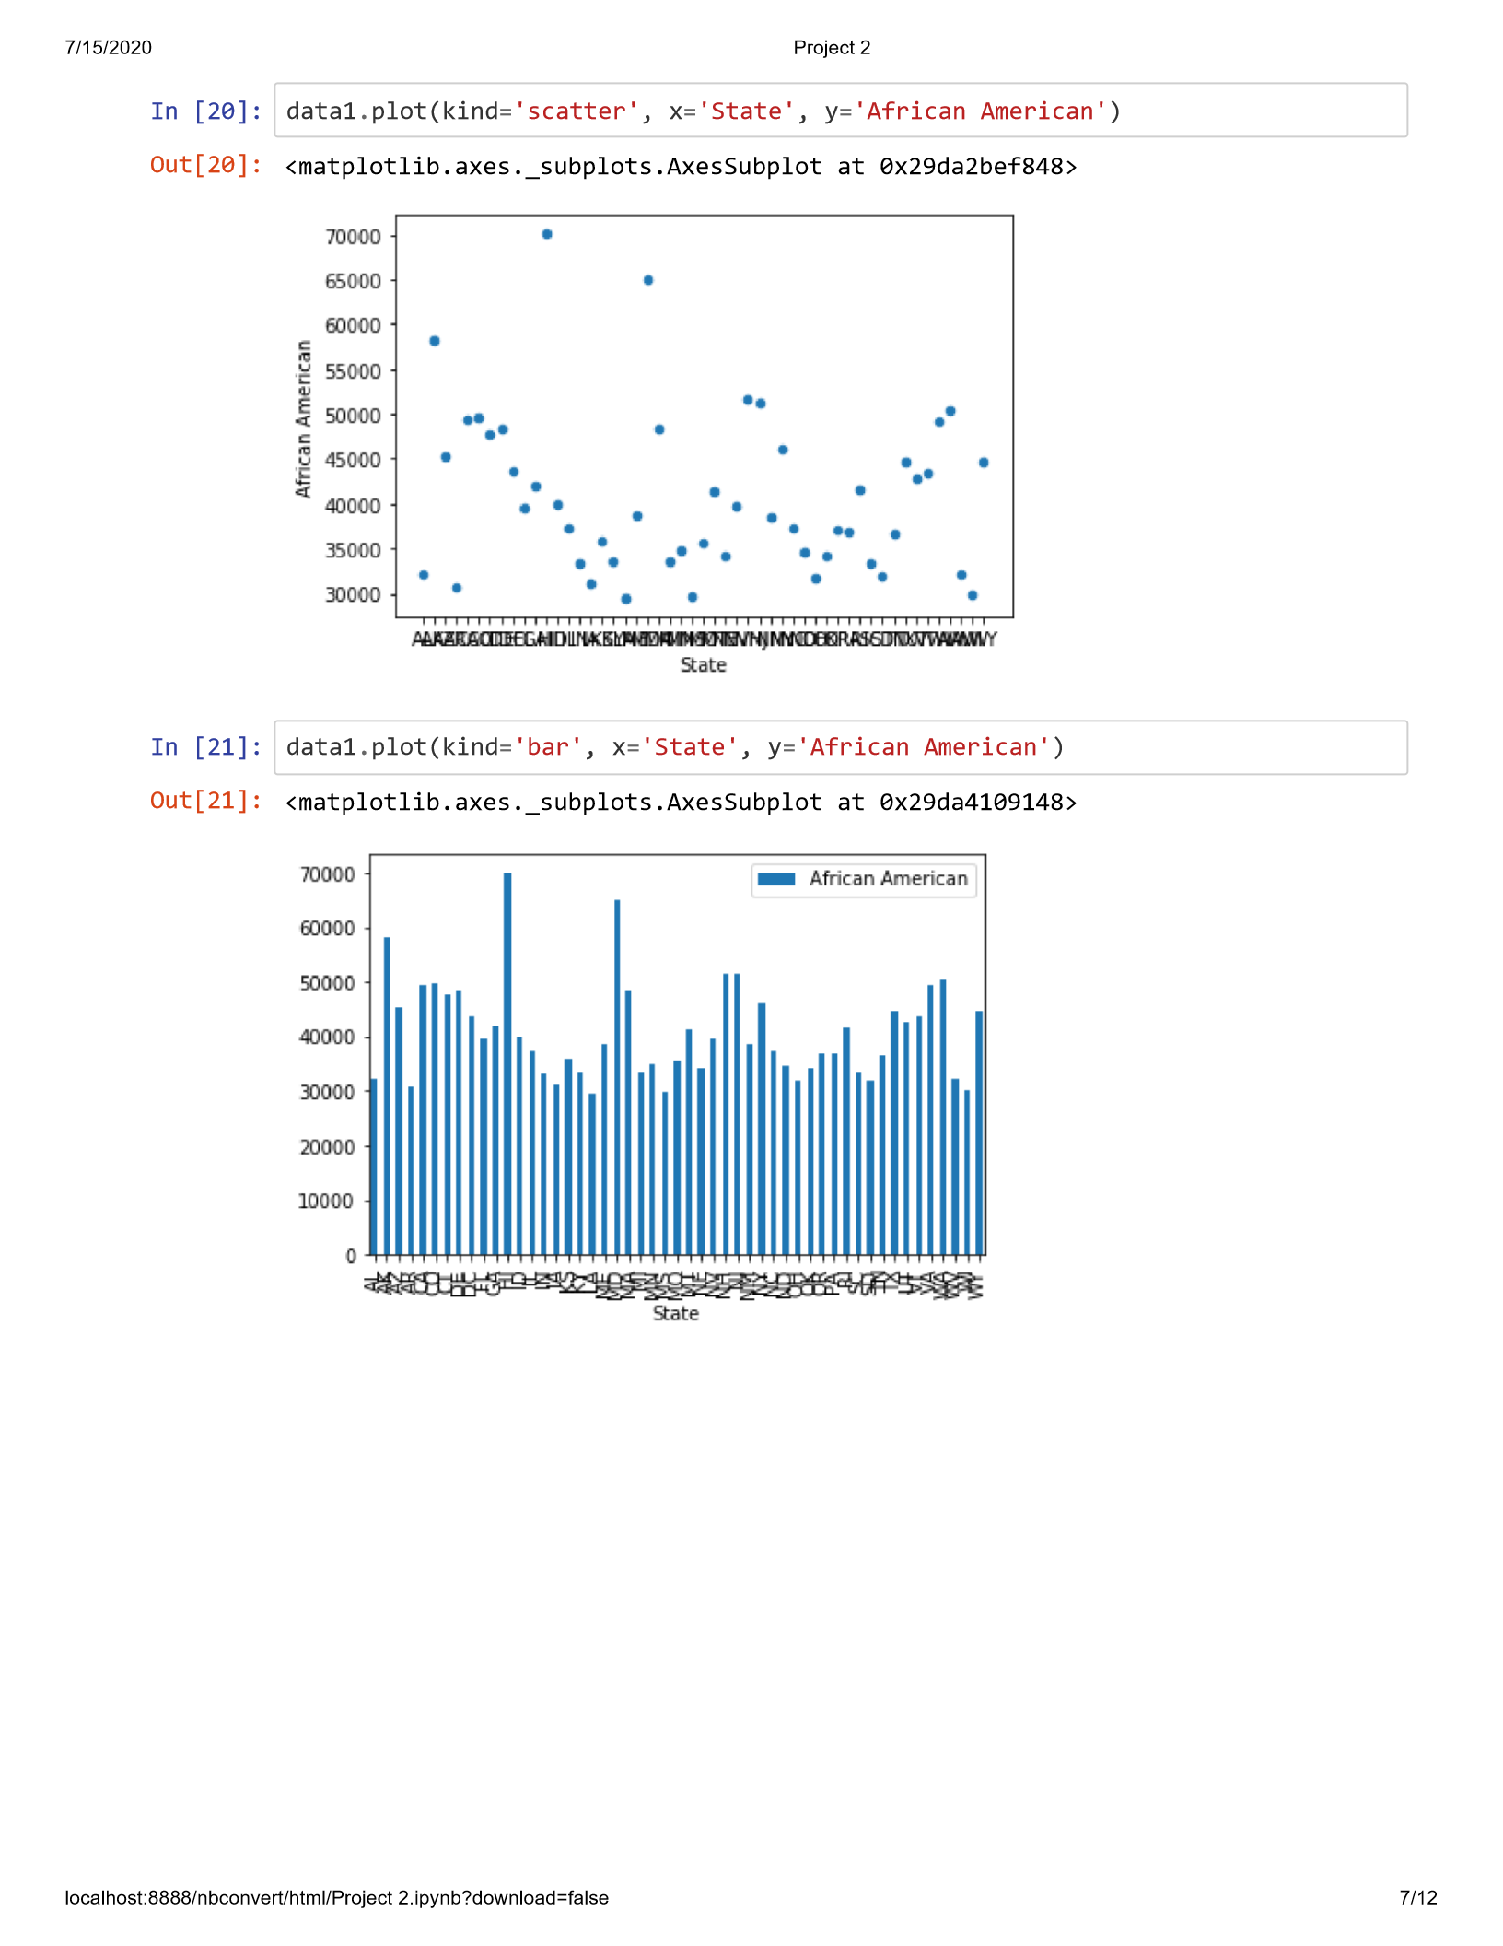
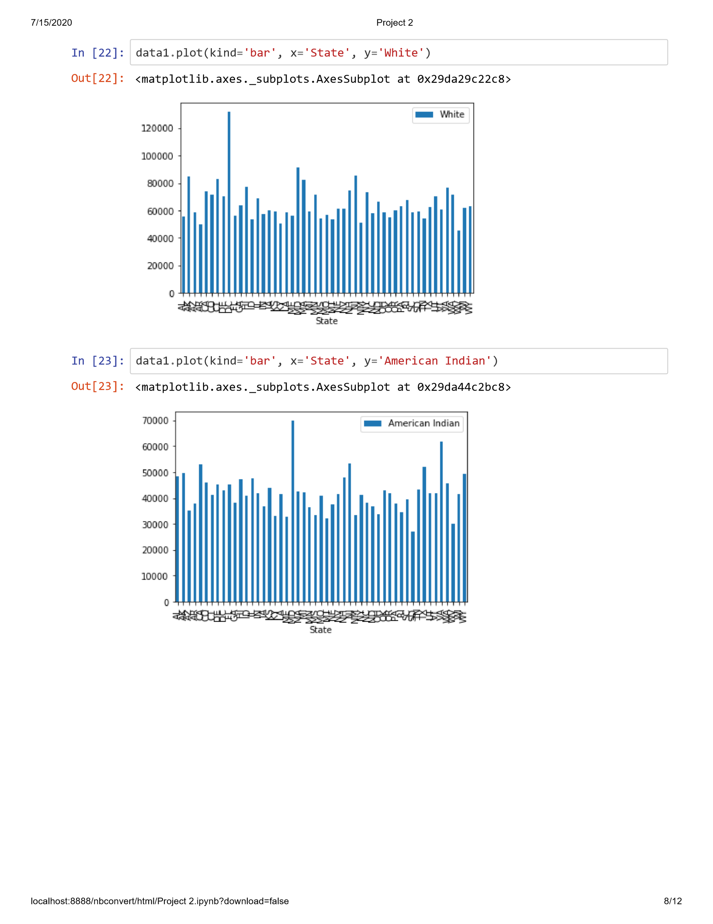

Slide 19
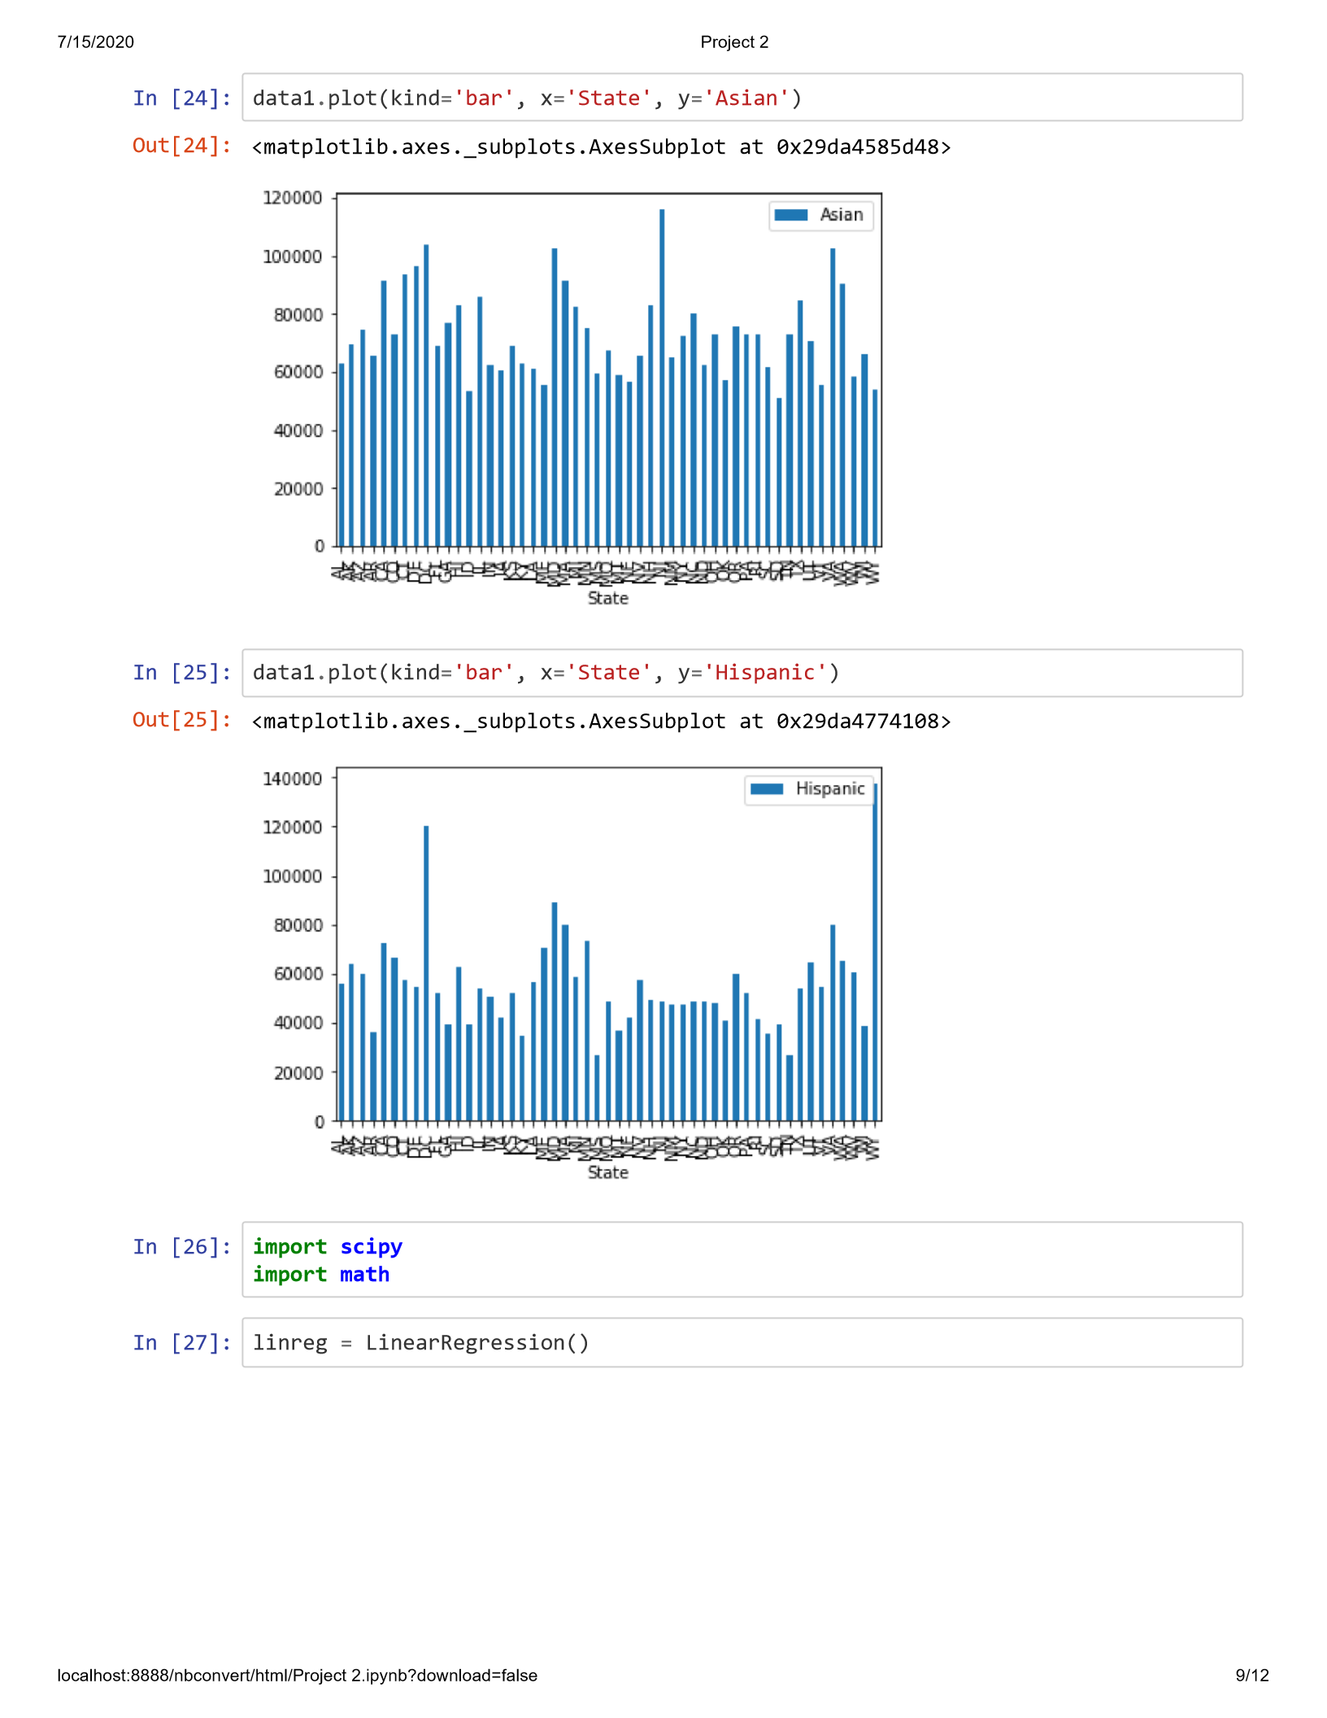
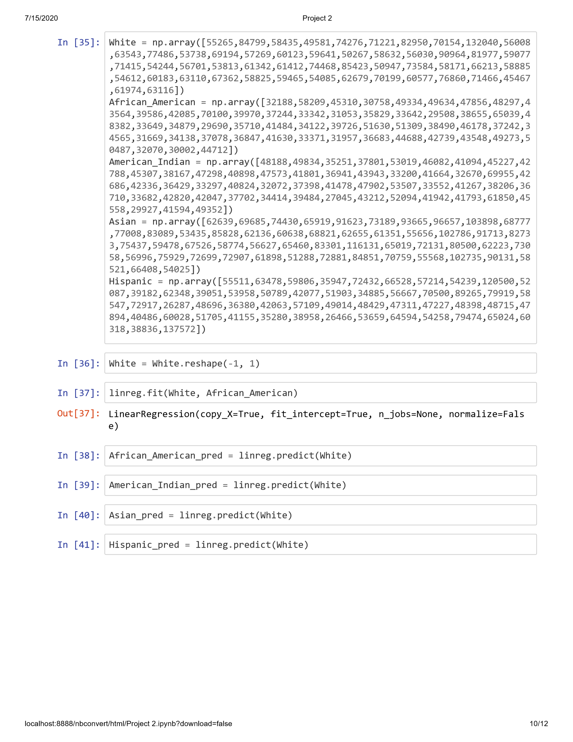

Slide 20
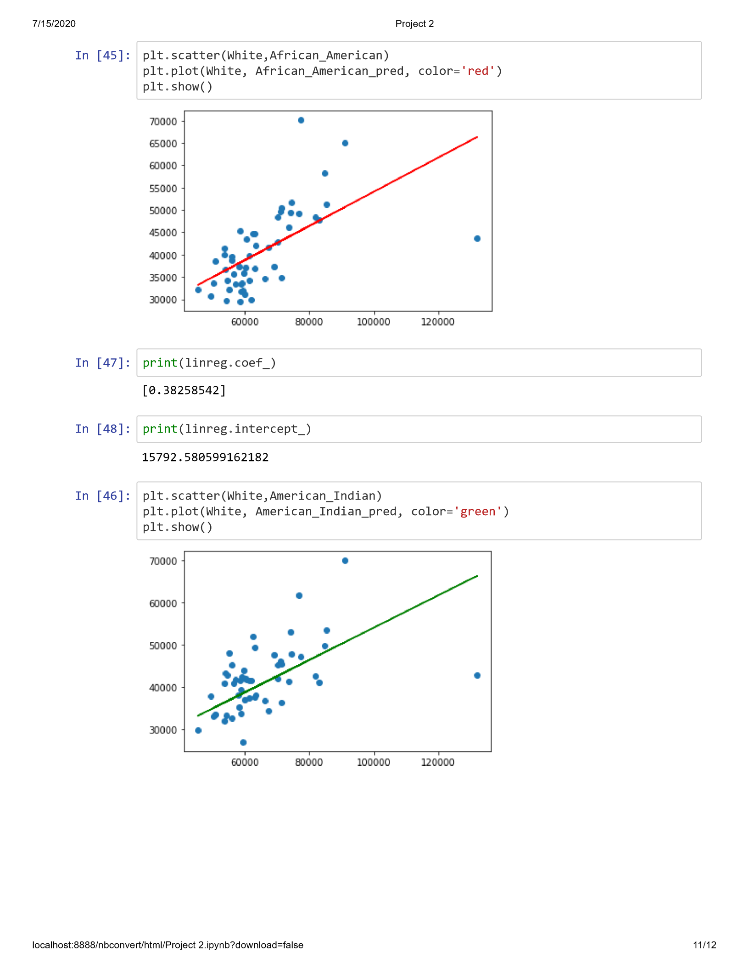
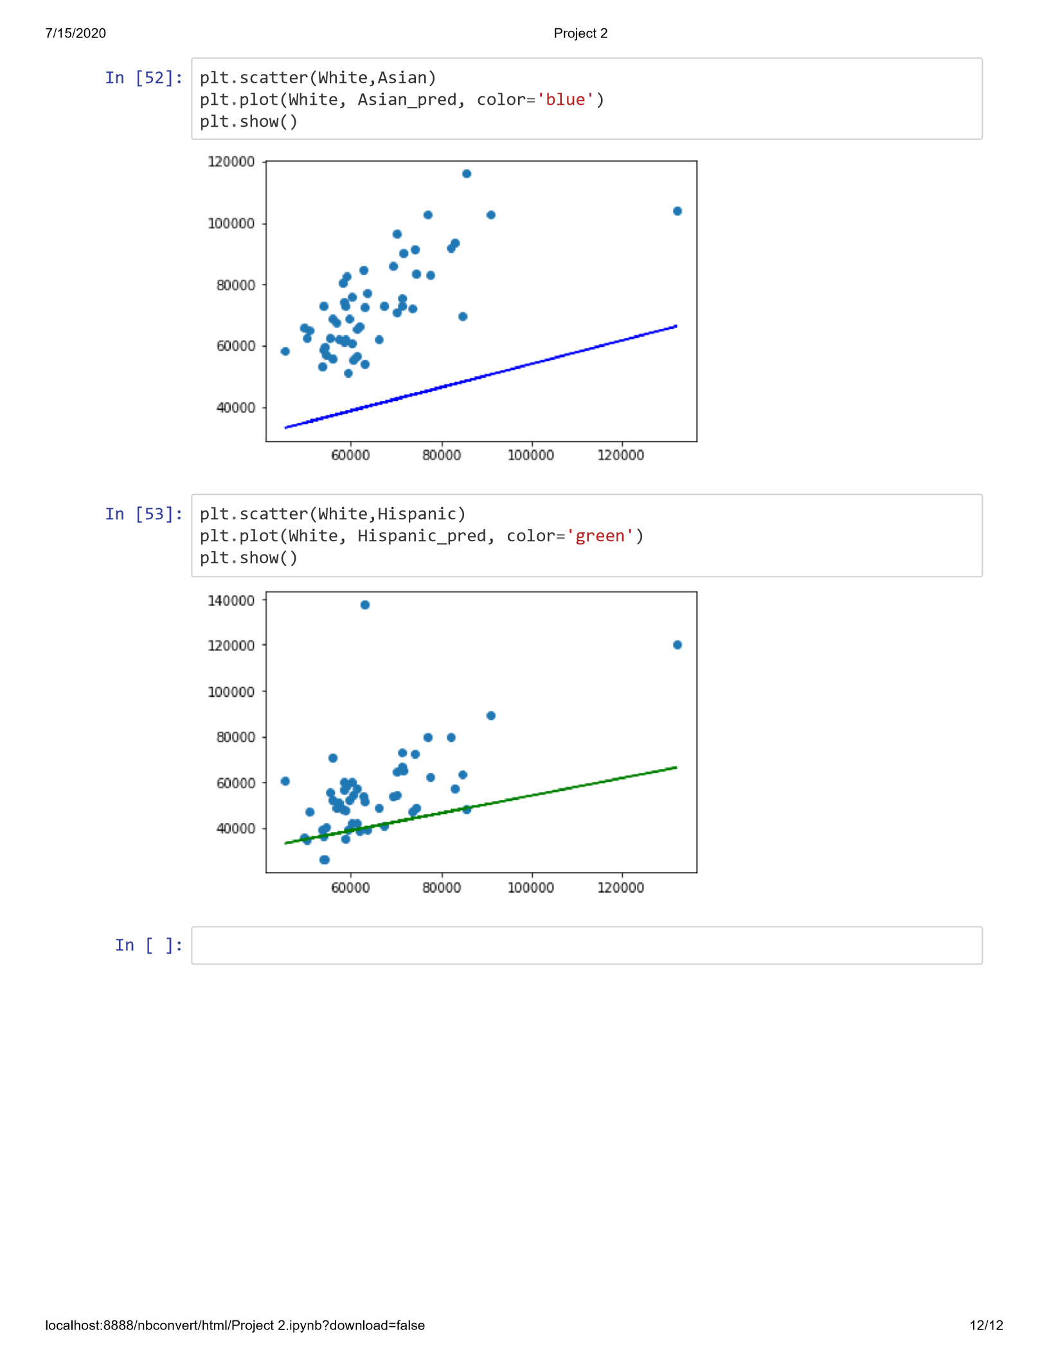

Slide 21
CONCLUSION
There are many factors that can explain the income inequality in the United States.
More than 75 percent of white households are married with spouse present, compared with less than half of black households.
This difference can be important because marriage allows people to pool their resources and, in general, accumulate more wealth.
Among primary respondents, almost 25 percent of whites are college graduates, compared with about 10 percent of blacks and Hispanics.
Less than half of Hispanics have a high school diploma.
Regardless of race or ethnicity, spouses have less education than primary respondents.
In the next part of this project, I will analyze the educational background of each race, I will also research income of each race in the past 10 years to find out if there are increases in income.

Slide 22
REFERENCES
https://www.census.gov/searchresults.html?q=income+by+race+in++florida&page=1&stateGeo=none&searchtype=web&cssp=SERP&_charset_=UTF-8
https://www.census.gov/data/datasets/time-series/demo/popest/2010s-state-detail.html
https://www.pgpf.org/blog/2019/10/income-and-wealth-in-the-united-states-an-overview-of-data
https://www.pewresearch.org/fact-tank/2018/07/12/key-findings-on-the-rise-in-income-inequality-within-americas-racial-and-ethnic-groups/
https://datausa.io/profile/geo/united-states
https://www.brookings.edu/blog/the-avenue/2019/10/03/black-household-income-is-rising-across-the-united-states/
https://www.pewsocialtrends.org/2018/07/12/income-inequality-in-the-u-s-is-rising-most-rapidly-among-asians/
https://www.epi.org/blog/racial-and-ethnic-income-gaps-persist-amid-uneven-growth-in-household-incomes/
https://news.gallup.com/poll/4435/public-overestimates-us-black-hispanic-populations.aspx
https://dqydj.com/income-by-race/

Slide 23
ACKNOWLEDGEMENTS
There are so many articles, data, and organizations that I owe great credit and great deals of respects to. After reading several articles, I realized that I needed to add more concepts into my research to make my projects more appealing and concrete. These articles have really helped me to understand some of the more important ways to structure my analysis.
Finally, I must thank my family especially my wife to allow me to skip so many family activities to focus on working in this project.

Slide 24
Author Information
Corresponding Author | Alberto Luma, 5802 Coquyt Drive Mount Dora, Fl, 32757 Email: lumaalberto@gmail.com
Author Affiliations | Bellevue University DSC680 – Applied Data Science

